Slide 1

POPSUI Registry
Training Webinar
Notes:
Standard title slide

Slide 2
Why do I need to be involved in POPSUI?

Slide 3
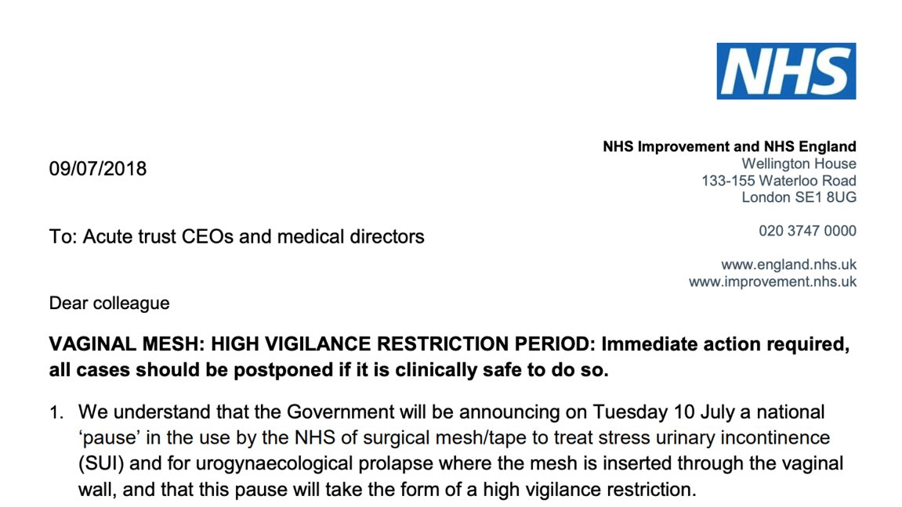

POPSUI Registry - Key Events
Initial Patient Review
  in February 2018, patient concerns about vaginal mesh were formally reviewed. Its use had been associated with significant, life‑changing complications.
  Pause on Mesh Use
  By July 2018, NHS England issued a letter pausing vaginal mesh usage due to safety concerns.
Independent Medicines and Medical Devices Safety Review
  The Cumberlege report, published in 2021, prompted creation of a registry.
  POPSUI is developed in 2025 to support safe reinstatement of services. Registry access to launch in 2026.
Notes:
Image source: Microsoft 365 content library
In February 2018, an initial review of patient concerns regarding vaginal mesh took place. By July 2018, NHS England issued a letter that placed a pause on the use of vaginal mesh. The Cumberlege report was published in 2021, leading to the introduction of a registry as part of the requirements to lift the pause.

Slide 4
Cumberlege Report - Recommendations
Criteria for lifting the pause were re-endorsed in the Cumberlege Report:
Operation Reporting Requirement
ii. (Surgeons must) report every operation to a national database;
Patient and Procedure Tracking
iii. A register of operations is maintained to ensure every procedure is notified and the patient identified who has undergone the surgery
Notes:
Image source: Microsoft 365 content library
The Cumberlege 'First Do No Harm' Report reaffirmed criteria for lifting the pause on mesh procedures. Surgeons must report every operation to a national database, and a register must track all procedures and patients. Compliance with the POPSUI Registry is essential for resuming these surgeries safely and transparently.

Slide 5

What will the POPSUI Registry achieve?
In addition to addressing historic concerns about pelvic mesh and associated complications and delivering the Cumberlege recommendations, the registry will:
Ensures consistent national recording of SUI, vaginal prolapse and rectal prolapse surgery
Support patient safety, service evaluation and quality assurance
Registry data may feed systems such as NCIP and Model Health System
POPSUI Registry compliance will evidence the patient‑safety criteria outlined in the update on the Cumberlege Report, which must be met before mesh procedures for stress urinary incontinence can be considered
Notes:
Image source: Microsoft 365 content library
The Cumberlege 'First Do No Harm' Report reaffirmed criteria for lifting the pause on mesh procedures. Surgeons must report every operation to a national database, and a register must track all procedures and patients. Compliance with the POPSUI Registry is essential for resuming these surgeries safely and transparently.

Slide 6
The Mandate for the POPSUI Registry
The request for data is issued under Directions from the Secretary of State and is therefore mandatory
Regular Audit of POPSUI registry entries vs HES data will take place to review compliance.
Expectation is that ALL required Clinicians and Admin staff will be onboarded onto the system.
The legal requirement is to record what you do.
POPSUI Registry and BSUG database serve different functions, and submission to POPSUI is legally required. Please contact BSUG directly with any questions about BSUG use or accreditation.
Due to the political sensitivity of this issue, surgeons performing procedures covered by POPSUI, who are not entering the required data, may be asked to cease this activity.
Notes:
Plain slide with subhead and bullets

Slide 7
Who is Involved in POPSUI?

Slide 8

POPSUI Registry Roll Out - Providers and Staff
Phase 1a (March 2026): Mesh centres, urogynaecology, urology. Initial roll out will be to providers who have been identified as key sites (next slide)
Phase 1b (TBC): Colorectal pelvic floor centres
Phase 1c (TBC): Mesh removal
Phase 2 (TBC): Further role out will be to all remaining sites. All providers delivering included procedures must participate.
Staff Groups Involved
Urogynaecology
Urology
Colorectal
Admin teams
Data leads
Trust governance and quality teams
Notes:
Plain slide with subhead and bullets

Slide 9
POPSUI Registry Roll Out - Phase 1 sites
# | Trust | Mesh Centres | Urogynaecology Subspecialty Training (SST) | Colorectal Pelvic Floor Centres | Urology Subspecialty Training (SST)
1 | Barts Health NHS Trust |  |  | X
2 | Birmingham Women’s and Children’s NHS Foundation Trust |  | X
3 | Cambridge University Hospitals NHS Foundation Trust | X | X
4 | East Sussex Healthcare NHS Trust |  |  |  | X
5 | Epsom and St Helier University Hospitals NHS Trust |  |  |  | X
6 | Gloucestershire Hospitals NHS Foundation Trust |  | X
7 | Guy’s and St Thomas’ NHS Foundation Trust |  |  | X | X
8 | Hull University Teaching Hospitals NHS Trust |  | X
9 | Imperial College Healthcare NHS Trust |  | X
10 | King’s College Hospital NHS Foundation Trust |  | X
11 | Kingston Hospital NHS Foundation Trust |  |  |  | X
12 | Leeds Teaching Hospitals NHS Trust |  | X
13 | Liverpool Women’s NHS Foundation Trust |  | X
14 | London North West University Healthcare NHS Trust |  |  | X | X
15 | Manchester University NHS Foundation Trust | X | X | X
16 | Mid Yorkshire Teaching NHS Trust |  |  |  | X
17 | Norfolk and Norwich University Hospitals NHS Foundation Trust |  |  |  | X
18 | North Bristol NHS Trust | X | X
19 | Nottingham University Hospitals NHS Trust | X |  | X
20 | Royal Berkshire NHS Foundation Trust |  |  |  | X
21 | Salisbury NHS Foundation Trust |  |  |  | X
22 | Sheffield Teaching Hospitals NHS Foundation Trust | X | X | X
23 | South Tees Hospitals NHS Foundation Trust |  |  |  | X
24 | Stockport NHS Foundation Trust |  |  |  | X
25 | The Newcastle upon Tyne Hospitals NHS Foundation Trust | X
26 | University College London Hospitals NHS Foundation Trust | X
27 | University Hospital Southampton NHS Foundation Trust | X |  | X
28 | University Hospitals Birmingham NHS Foundation Trust |  | X |  | X
29 | University Hospitals Bristol and Weston NHS Foundation Trust |  |  | X
30 | University Hospitals of Leicester NHS Trust | X | X
31 | University Hospitals Plymouth NHS Trust |  | X | X
32 | Worcestershire Acute Hospitals NHS Trust |  | X
Notes:
Plain slide with subhead and bullets

Slide 10
What procedures must be submitted to the POPSUI Registry?

Slide 11
Procedures Included - Mesh and Mesh Comparator Procedures
Mesh Procedures
  Any mesh insertion for stress incontinence, pelvic organ prolapse, rectal prolapse/intussusception
Comparator Procedures
  Defined as alternatives to mesh procedures for outcome comparison
Notes:
Plain slide with subhead and bullets

Slide 12
Procedures Included - Mesh and Mesh Comparator Procedures
SUI - All SUI operations including:
  Mesh: e.g. retropubic mesh sling
  Non-mesh: Autologous sling, colposuspension, AUS, bulking, other
Prolapse - All mesh insertions and vault /uterine support procedures where mesh is a comparator
  Mesh: e.g. sacrocolpopexy, sacrohysteropexy, vaginal mesh insertion
  Non mesh: e.g. sacrospinous fixation, uterosacral suspension, Manchester repair, colpocleisis, vaginal hysterectomy and McCall Culdoplasty
Colorectal - Mesh insertion and procedures for rectal prolapse/intussusception where mesh is a comparator
  Mesh: e.g. ventral mesh rectopexy
  Non mesh: e.g. suture rectopexy, Delormes, Altmeier, STARR procedure
Notes:
Plain slide with subhead and bullets

Slide 13
Procedures NOT Included
Single site anterior/posterior repairs (without mesh)
Botox for OAB
Sacral nerve stimulation (separate registry)
Faecal incontinence procedures without prolapse surgery
Notes:
Plain slide with subhead and bullets

Slide 14
Using the POPSUI Registry

Slide 15
POPSUI Registry - Accessing the system
POPSUI data entry has been available since 13th March
As much as possible, the administrative activities for data entry should be undertaken by admin teams. This includes creating patients on the system and generating pre-operative PROMs, ideally, several weeks before surgery or at the time of listing
Registry Website:
https://www.outcome-registries-platform.nhs.uk/ORP/outcomes/SignIn
Login using forgotten password function
Accounts issued during the pilot phase remain valid for registry access
User Guides and short videos available to all
Notes:
Plain slide with subhead and bullets

Slide 16
POPSUI Registry - Data Entry and Terminology
Data Entry Process
    1. Search/Creation of the patient record and then;
    2. Adding the patient’s procedure to that patient
Treatment
A distinct diagnostic or therapeutic clinical intervention. A patient may have multiple “records” of different types submitted (e.g. PROMs, Operation, Post Operative Complications). To enable records to be grouped correctly, the platform uses the term ‘Treatments’.
Records
The POPSUI Registry is split into 4 linked datasets which are defined in the ORP as “Records”
  1. POPSUI Pre-Op PROMS
  2. POPSUI v2.0 (Operation)
  3. Post Operative Complications
  4. POPSUI Post-Op PROMs
Notes:
Plain slide with subhead and bullets

Slide 17
POPSUI Registry - PROMs
Pre‑operative PROMs When patients are added to the registry in advance by admin, the pre‑op PROM is generated automatically and emailed directly to the patient for completion, with scores recorded in the registry. Admins must include the patient’s email address when adding a patient so PROMs can be issued automatically. Paper versions are available for in‑person completion but are not recommended, as they require manual transcription onto the registry platform by admin colleagues. Post‑operative PROMs The 6‑month post‑op PROM is sent automatically by email. PROM versions We are using an interim PROM and will transition to the APPRAISE PROM in due course.
Notes:
Plain slide with subhead and bullets

Slide 18
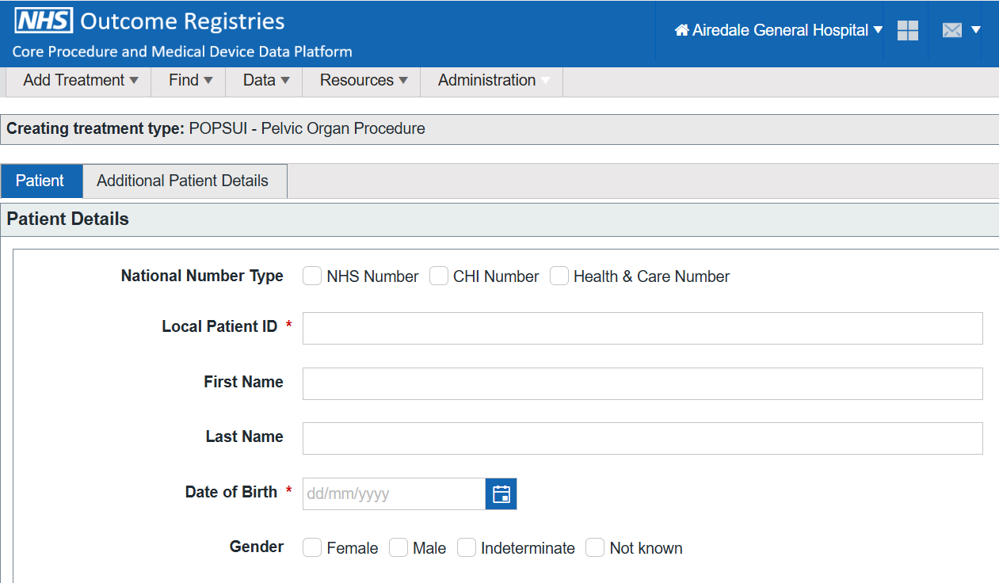
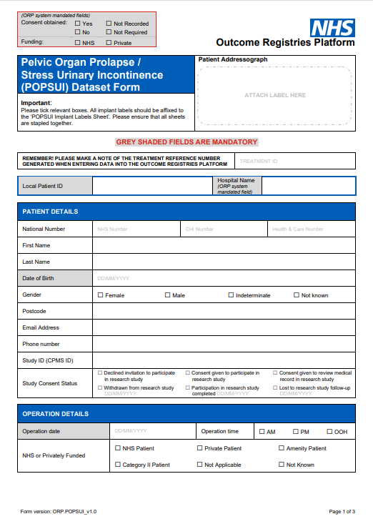
POPSUI Registry - Record completion
Record completion takes approximately 5–10 minutes per patient.
Surgeons can view their own procedures. Data managers can extract full site dataset
    Essential - Admin support to add patients before clinical entry can begin
    Patients MUST be created on the system in advance of the procedure by admin colleagues
    Enter weeks in advance - at listing or MDT – so that pre‑op PROM can be generated.
Two main methods to add procedures to the registry.
1. Direct to registry
2. Paper proforma first and then transferred to registry
Records are completed on a paper proforma by clinical colleagues for later transfer by administrative colleagues to the registry. Implant stickers on the proforma will facilitate scanning.
Notes:
Plain slide with subhead and bullets

Slide 19
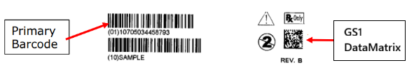
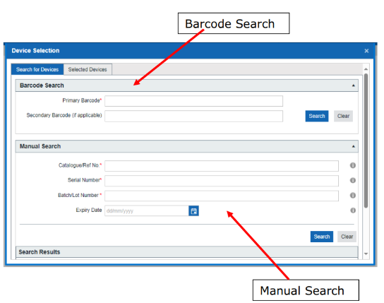
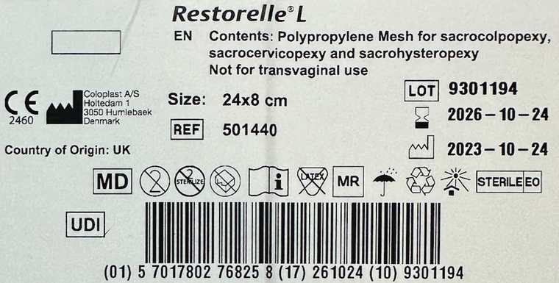
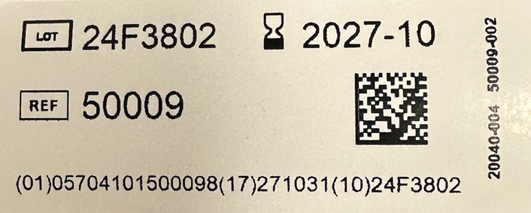
POPSUI Registry – Devices and Barcode Scanning
Device Entry - barcode scanning or manual data entry
Device details are captured for mesh, AUS and bulking
Standard barcode scanners are supported (plug and play)
Manual device entry available - search using ref no. and serial/lot
Example GS1 128 linear barcode: Example GS1 Data Matrix:
Notes:
Plain slide with subhead and bullets

Slide 20
POPSUI Registry Live Demo

Slide 21
Next Steps and Further Information

Slide 22
POPSUI Registry – Next Steps
Request registry account: POPSUI Registry User Account Request Form.
Nominate a ‘POPSUI’ lead for your unit – to coordinate registry activity for your site.
Use the POPSUI Registry.
Usage statistics will be reported to unit (fortnightly initially, moving to monthly).
POPSUI Registry dashboard is in development. Using SUS data to support compliance.
Please access this recording, the POPSUI FAQs and POPSUI User Guide as the first line of support (all on NHS Futures).
If your question is not answered there or you encounter an issue, please email england.support.outcomeregistries@nhs.net and the team will assist you.
POPSUI Registry – Support
Notes:
Plain slide with subhead and bullets

Slide 23
POPSUI Registry - Resources
POPSUI NHS Futures Webpage which includes contact information, updates, training guides and training recordings.
POPSUI Registry User Account Request Form
POPSUI Registry Web Portal
POPSUI Training Video
POPSUI Training Slides
POPSUI User Guide
POPSUI FAQs
Notes:
Plain slide with subhead and bullets

Slide 24
Q & A

Slide 25


Contact us
    england.popsui.outcomesandregistries@nhs.net
    ORP - NHS England Website
    ORP - NHS Futures POPSUI Microsite

Slide 26
Appendix

Slide 27
POPSUI Information Governance and Legal Basis
Useful Weblinks:
Outcomes and Registries Directions (2024)
Data Provision Notice (DPN)
Information Standards Notice (ISN)
Transparency Notice
ORP Platform Cyber Assurance Guide
Legal Basis for Submission
Data submission to the POPSUI registry is mandated under Section 259 of the Health and Social Care Act. All NHS-commissioned healthcare providers must submit data for NHS patients. Therefore, no separate data-sharing agreement, patient consent, or additional provider-level IG activity is required.
As a device level registry, POPSUI is included in the Medical Devices Outcomes Registry (MDOR) information governance framework. Additional DPIAs are generally unnecessary, as providers’ transparency notices already allow data sharing with NHS England for direct care; POPSUI’s statutory direction falls under this provision.
DPIA - If your organisation chooses to complete a DPIA, it must be done under your own IG framework. NHS England cannot complete DPIAs for providers or share its internal DPIAs but can advise on specific queries.
DTAC - Healthcare provider led DTACs are not required for NHS England’s ORP Platform, it applies only if you procure a new third-party digital tool to create or transmit MDOR data.

